Slide 1
Project-149
Telecommunication Customer Churn Prediction
On the base of attributes we are going to predict whether customer will churn or not.
Mentor- Mr. Varun & Miss Munnagi Ramya
Starting date- 28/08/2022
MEMBERS
Malay jana
Mrs.Madhusmita Pany
Mr. Onkar Kandar
Dimple Klair
Mr.Nitesh W Kumbhare
Mr. Khamkar Dipak Vishvanath

Slide 2
Business objective and Problem:
The telecommunications industry experiences an average of 15-25% annual churn rate, and it costs 5-10 times more to acquire a new customer than to retain an existing one, that's why customer retention has now become even more important than customer acquisition.
Finding those factors that increase customer churn is important to take necessary actions to reduce this churn.
So, The main goal of our project is to develop an understanding of the cause of customer churn which assists telecom operators to predict customers who are most likely subject to churn, and what to do to retain the most valuable customer.

Slide 3
Project Architecture
Model Building
Dataset
Manual EDA
Standardizing Data
Feature Selection using 2 methods
Automatic EDA
Model Building
Balancing the Dataset
Model Deployment

Slide 4
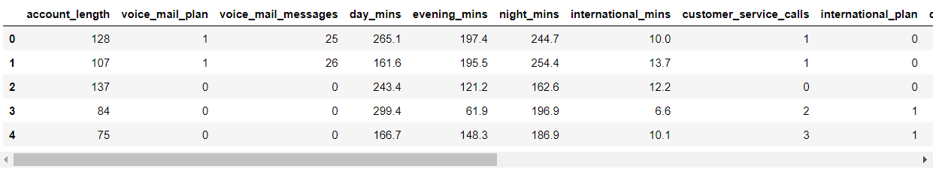
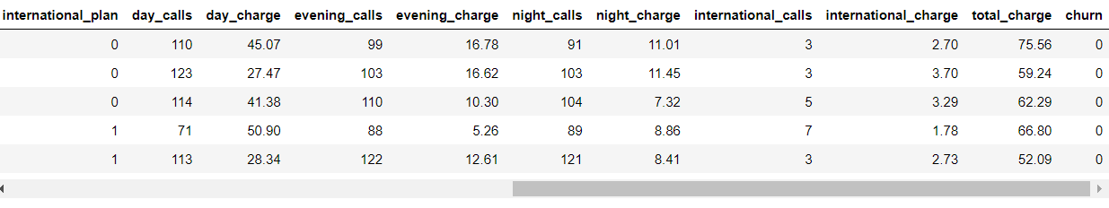

Dataset we have
df1.shapeddf1.fff.shape1.shape

Slide 5
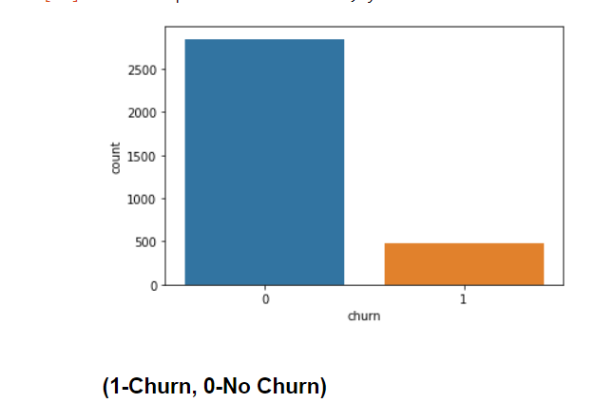
Manual EDA
In [9]:
len(df1[df1.duplicated()])
Out[9]:
0
In [10]:
print(df1.churn.value_counts())
0 2850
1 483
Name: churn, dtype: int64
data is not balanced

Slide 6
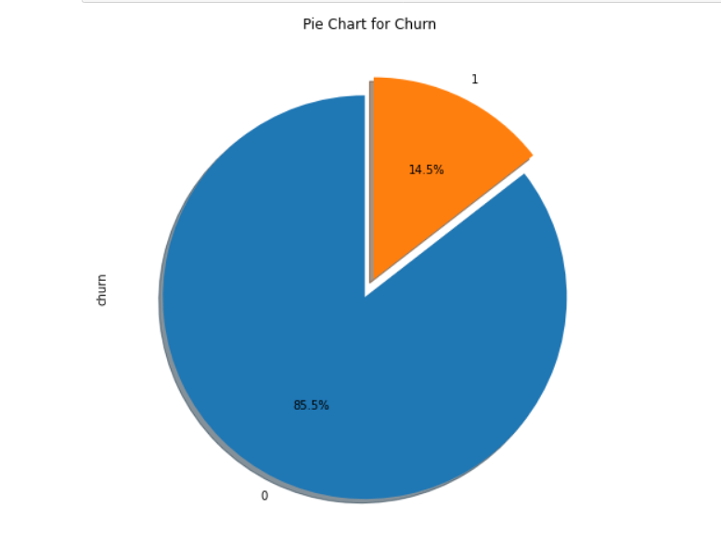
Analyse the Target variable

Slide 7
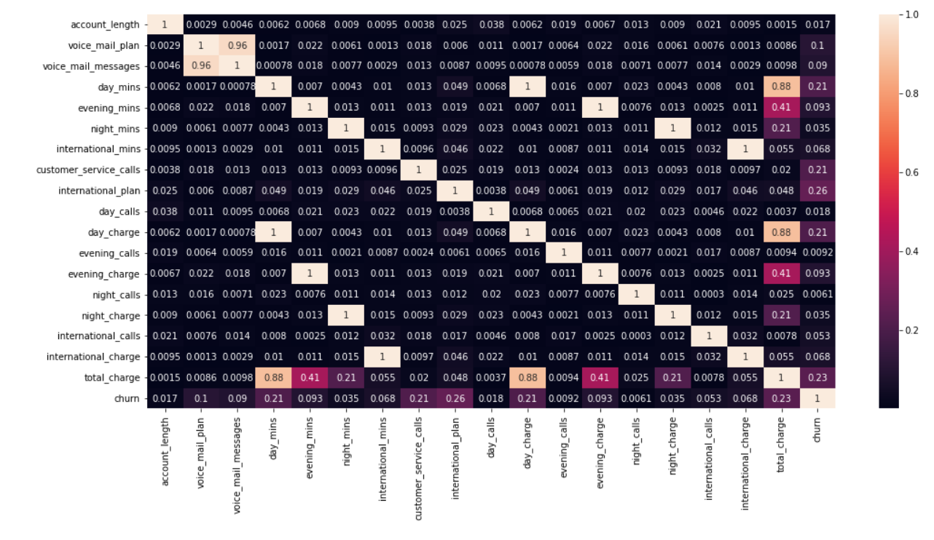
correlation matrix/heatmap

Slide 8
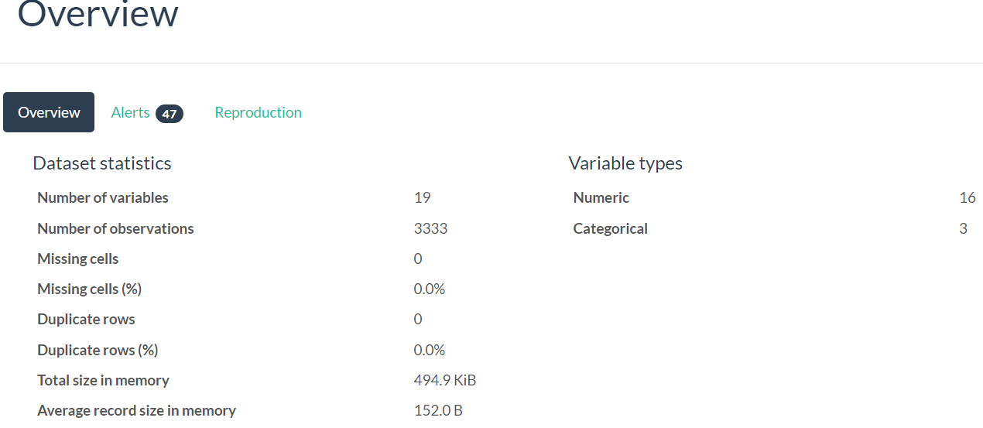
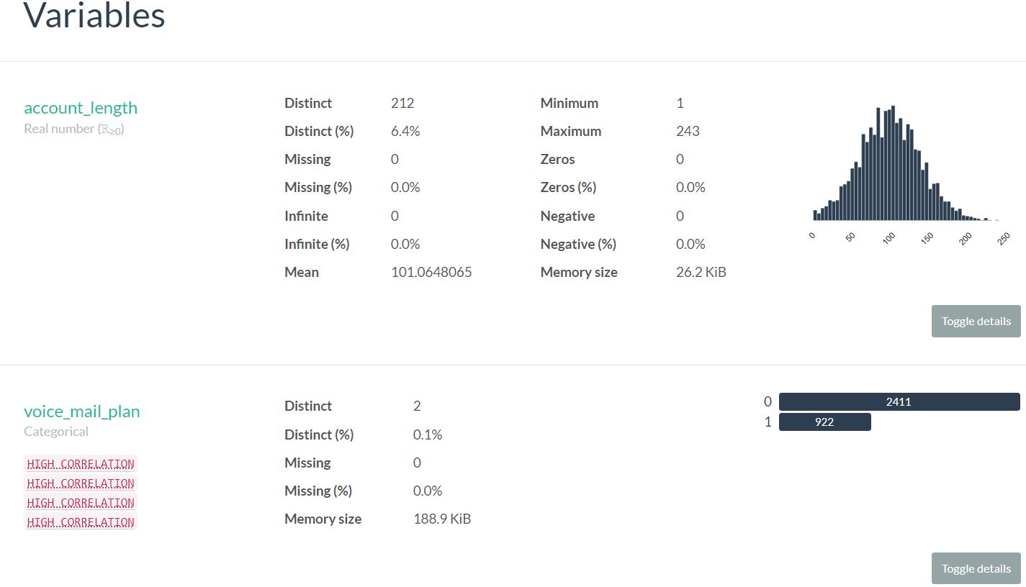
Automatic EDA
Through 2 ways:- 1. pandas profiling

Slide 9
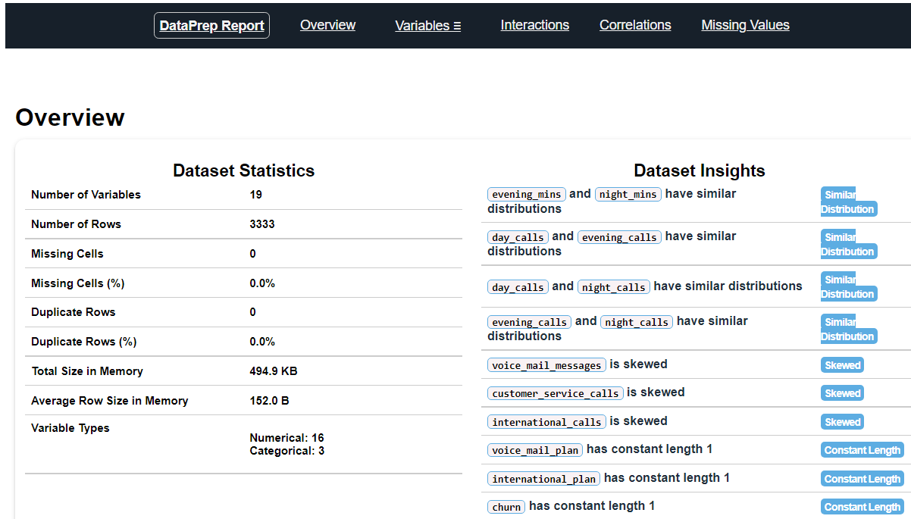
2. EDA- using dataprep

Slide 10
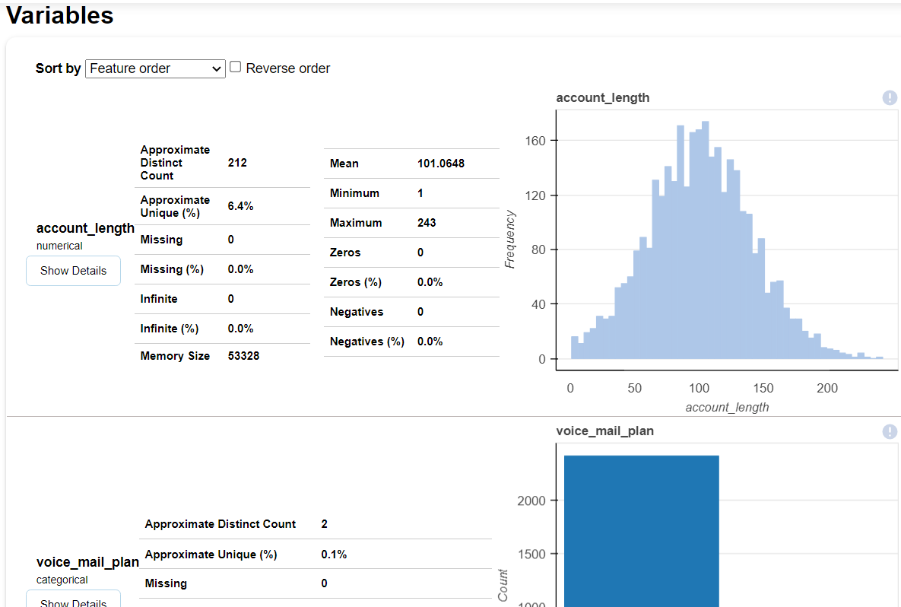
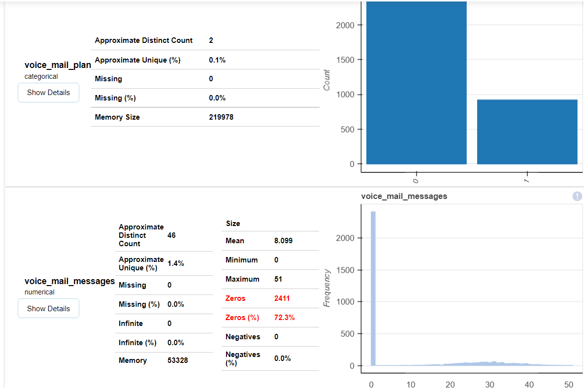

Slide 11
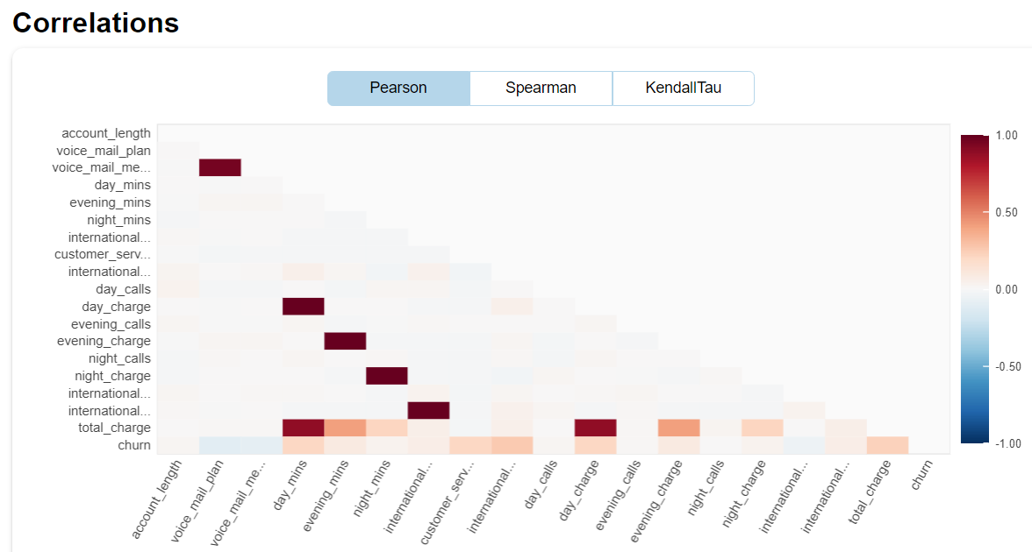

Slide 12
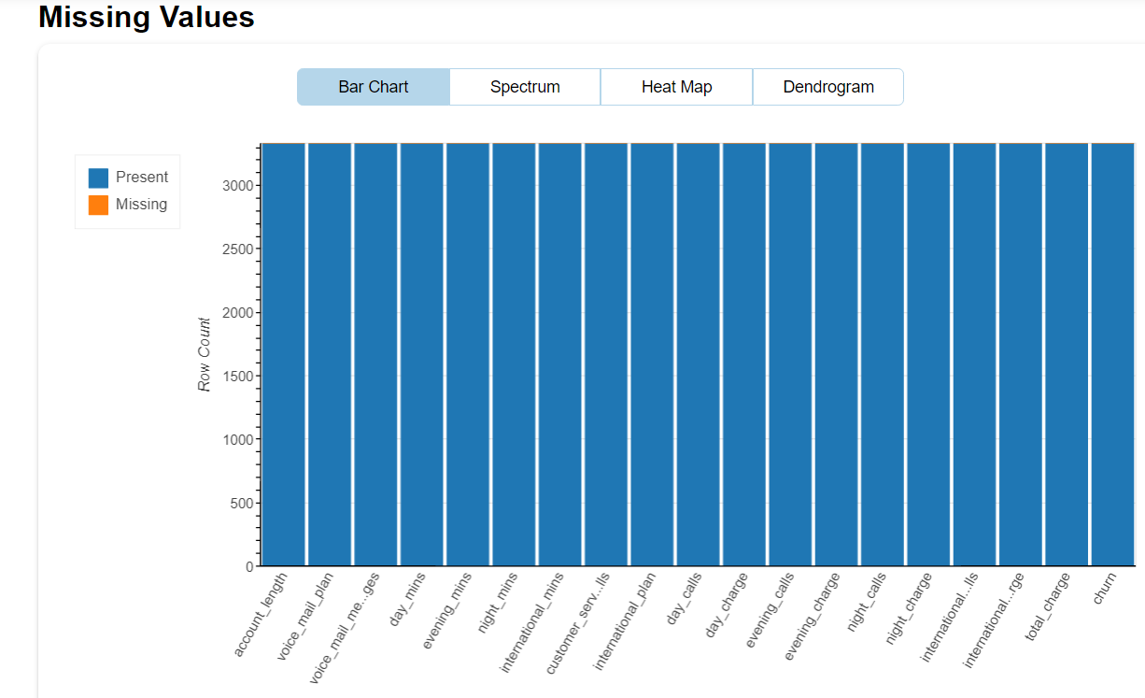

Slide 13
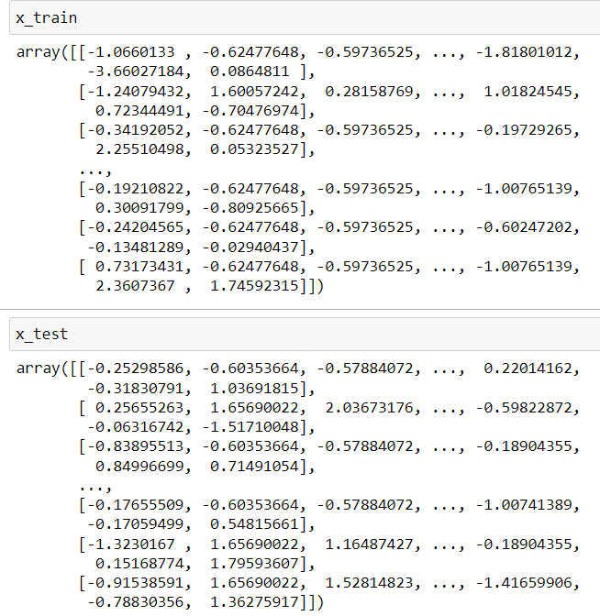
FEATURE SCALING—standardizing the data

Slide 14
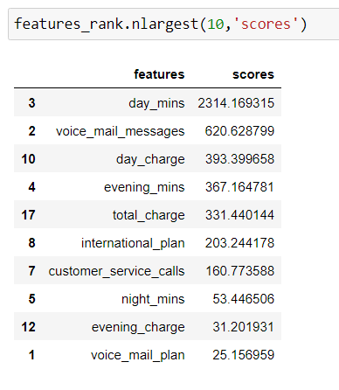
FEATURE SELECTION- using different methods
1.Univariate analysis—applying SelectKBest

Slide 15
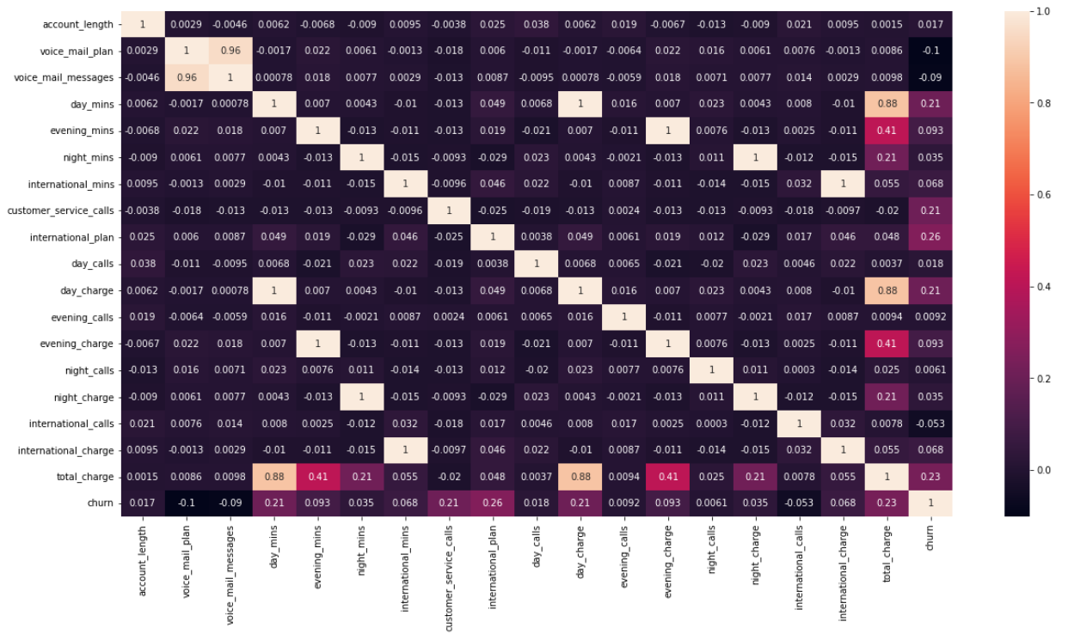
2. Correlation techniques

Slide 16
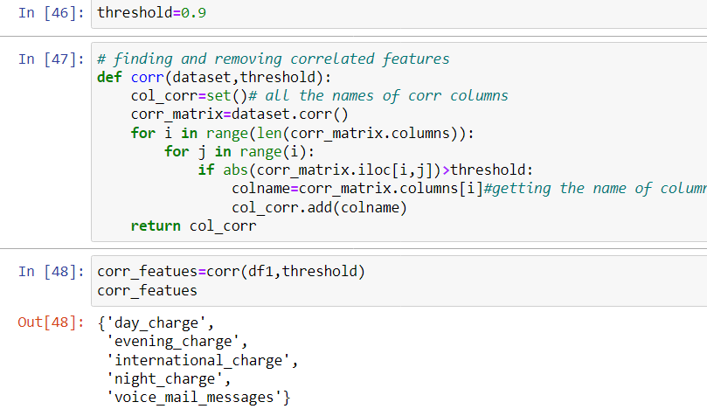
Removing one of the highly correlated features

Slide 17
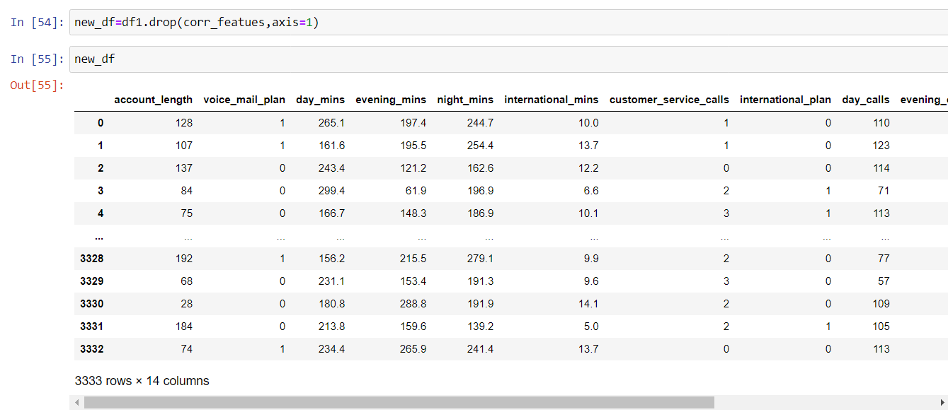
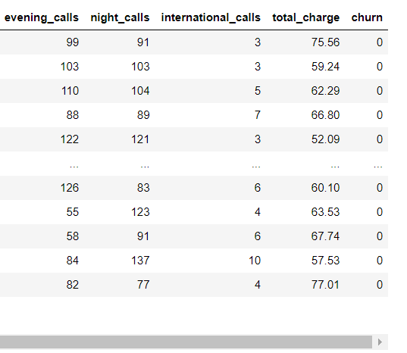


Slide 18
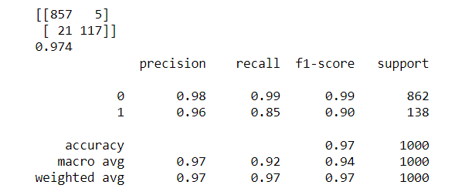
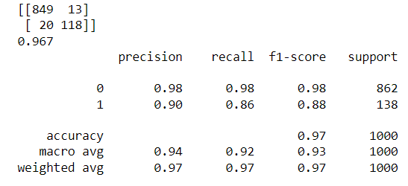
Balancing dataset
By using:- 1.oversampling- we used RandomOverSampler on
RandomForestClassifier and got 97% accuracy.
the number of classes before fitCounter({0: 1988, 1: 345})
the number of classes after fitCounter({0: 1988, 1: 994})
By using:- SMOTETomek- used this tech on same algo
RandomForestClassifier and got less acc. than oversampling.
the number of classes before fitCounter({0: 1988, 1: 345})
the number of classes after fitCounter({0: 1981, 1: 987})

Slide 19
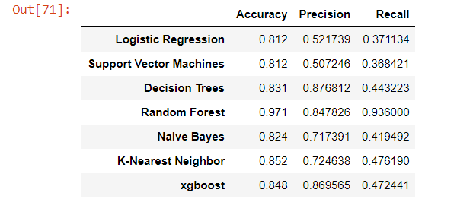
Model Building

Slide 20
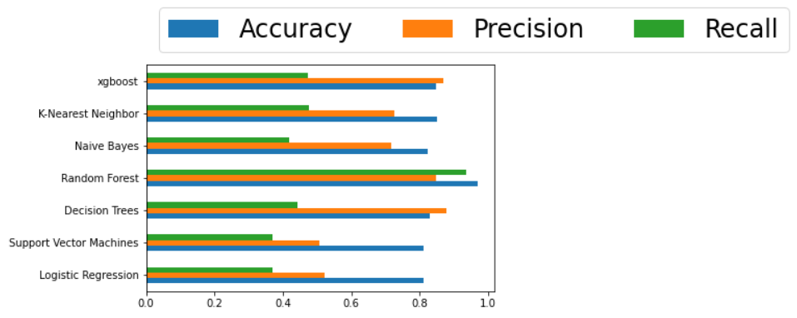

Slide 21
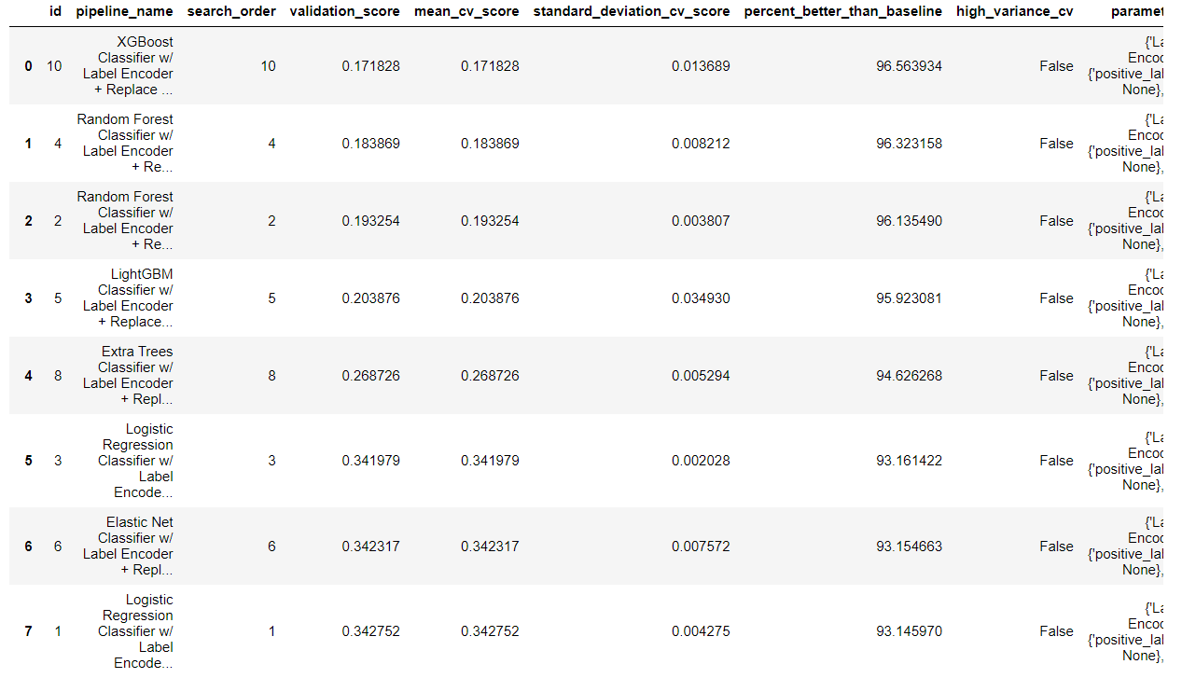
AUTOML using evalml

Slide 22
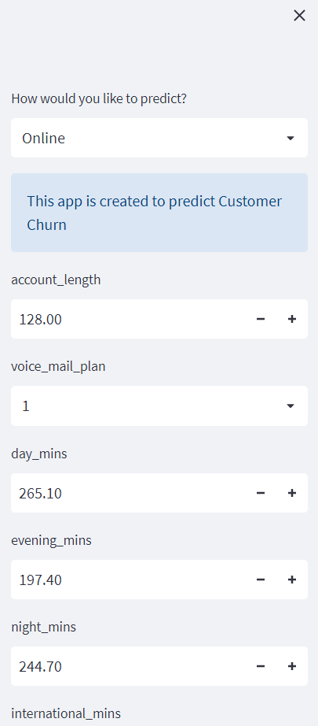
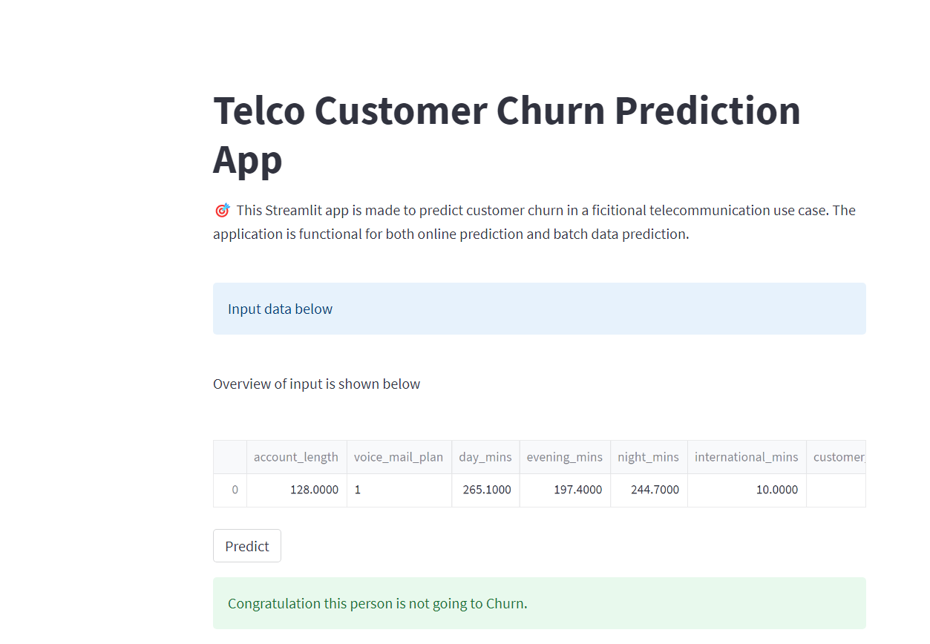
Deployment

Slide 23
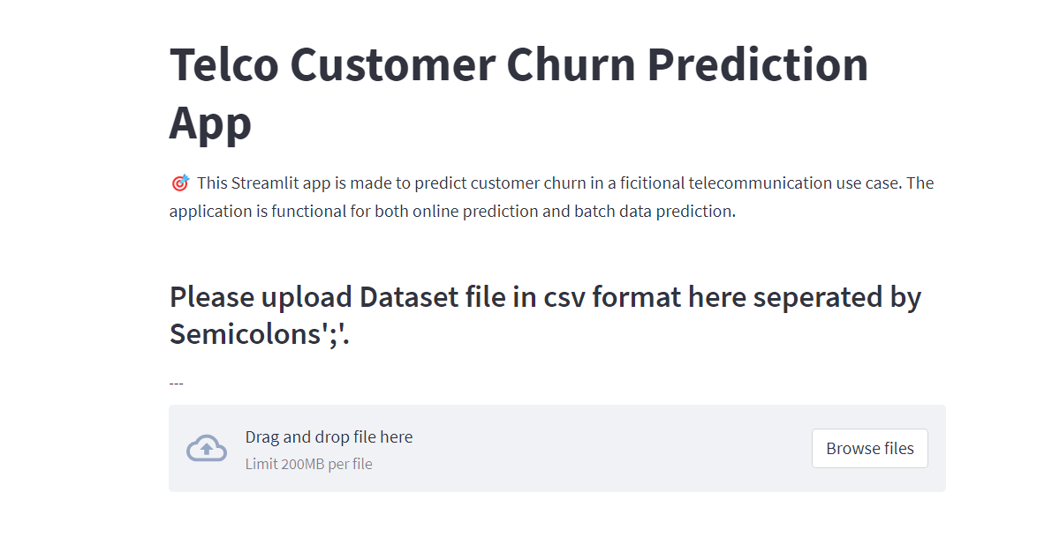
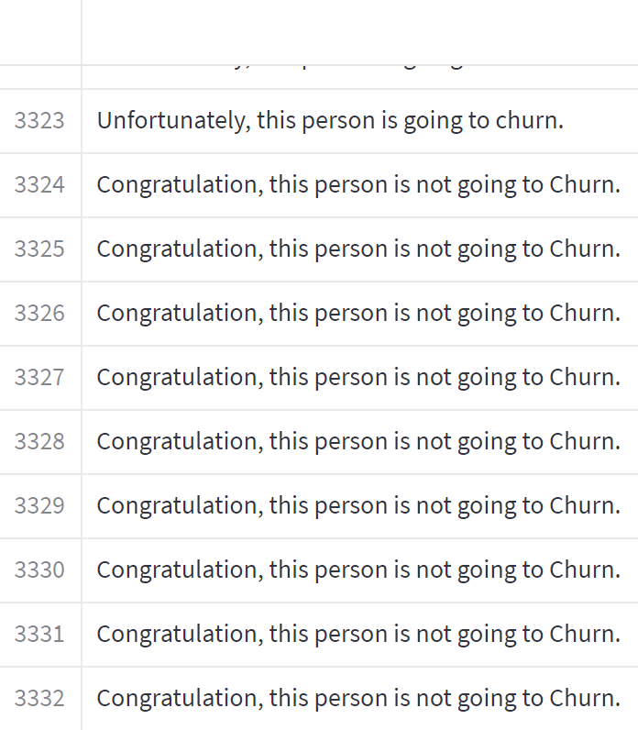

Slide 24
Challenges we faced
1.The dataset was imbalanced, so we balanced it using oversampling technology.
2.There are total 18 features, many of them are highly corelated. so we dropped one of those corelated features using a thresheshold value which was 0.9 and finally we have 13 features to perform our task.
3.We were very much confused as Both xgboost and RandomForest were giving good accuracy but we choosed RandomForest according to the precision and recall values.

